Slide 1
Design Network Implementation
Monitoring
Azure DNS
Security
Azure
Networking
Hybrid Connection
Express Route
Network Services
Fazal M Raza
Azure Technology Specialist

Slide 2
70-535 Exam Network Objectives (15% - 20%)
Design Azure virtual networks
Design solutions that use Azure networking services: design for load balancing using Azure Load Balancer and Azure Traffic Manager; define DNS, DHCP, and IP strategies; determine when to use Azure Application Gateway; determine when to use multi-node application gateways, Traffic Manager and load balancers
Design external connectivity for Azure Virtual Networks
Determine when to use Azure VPN, ExpressRoute and Virtual Network Peering architecture and design; determine when to use User Defined Routes (UDRs); determine when to use VPN gateway site-to-site failover for ExpressRoute
Design security strategies
Determine when to use network virtual appliances; design a perimeter network (DMZ); determine when to use a Web Application Firewall (WAF), Network Security Group (NSG), and virtual network service tunneling
Design connectivity for hybrid applications
Design connectivity to on-premises data from Azure applications using Azure Relay Service, Azure Data Management Gateway for Data Factory, Azure On-Premises Data Gateway, Hybrid Connections, or Azure Web App’s virtual private network (VPN) capability; identify constraints for connectivity with VPN; identify options for joining VMs to domains

Slide 3
Azure Virtual Network Overview
What Azure locations will you use to host VNets?
Do you need to provide communication between these Azure locations?
Do you need to provide communication between your Azure VNet(s) and your on-premises datacenter(s)?
How many Infrastructure as a Service (IaaS) VMs, cloud services roles, and web apps do you need for your solution?
Do you need to isolate traffic based on groups of VMs (i.e. front end web servers and back end database servers)?
Do you need to control traffic flow using virtual appliances?
Do users need different sets of permissions to different Azure resources?
Isolated
50/1000 Virtual Networks per Region per Subscription
Up to 500K Concurrent TCP connections per NIC per VM
9/25 DNS servers per Vnet
20 custom DNS servers per Vnet
Internet Connected by default
Use Public IP address Ranges and Private IP Address ranges
Some IP address Ranges are not allowed:
224.0.0.0/4 (Multicast)
255.255.255.255/32 (Broadcast)
127.0.0.0/8 (loopback)
169.254.0.0/16 (link-local)
168.63.129.16/32 (Internal DNS)
Vnet properties
Name
Location
Address Space
Subnets
DNS server
Subnet properties
Name
Address Prefix
IP Configuration
Network Security Groups
Route Tables
https://docs.microsoft.com/en-us/azure/azure-subscription-service-limits
Notes:
All software defined
Basis for networking is a Virtual Network
equivalent to a Vlan in on-perm environment
Bring your own network
Specify your own Address Space –
define your own subnets
No IP Conflict
Bring your own DNS or use Azure provided DNS
Example of Dev and Prod environments
Lets now see how to setup communication between two Virtual networks that are in Azure by using Virtual network peering feature
___________________________________________________________________________-
Front end Piece –
End customers connecting to public endpoints of your service
Private End –
Connect offices or datacenters via private link to Azure which can be either internet based (IPSEC VPN) or dedicated link called ExpressRoute – which we cover in little more detail in this session
Secure with network security group ACLs
Control traffic with User Defined Routes (UDR’s)
Ask Allan for Cloud vs ON-prem Network differences

Slide 4

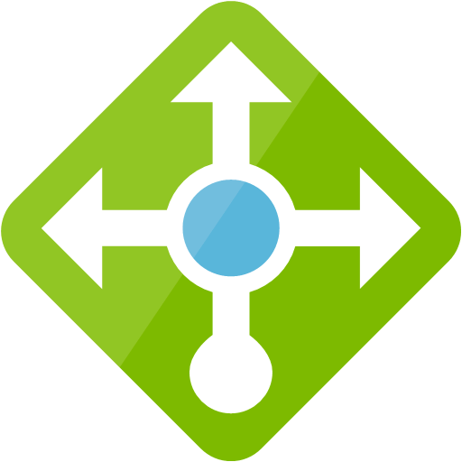


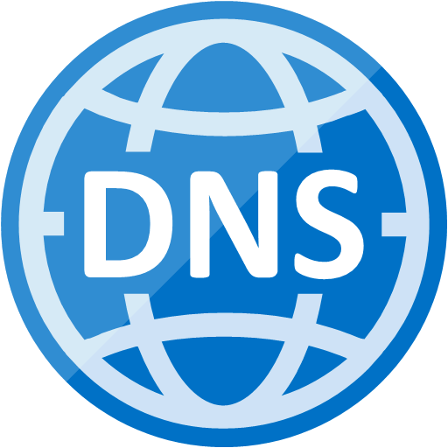


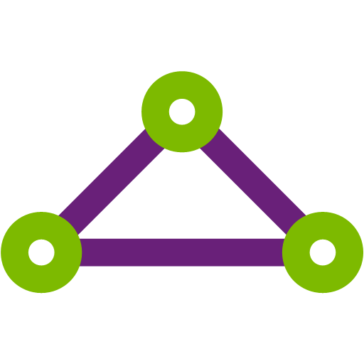

Robust networking infrastructure services
Virtual Network
Provision private networks, optionally connect to on premise datacenters. NSG, User Defined Routes, & IP addresses.
Load Balancer
Deliver high availability and network performance to your applications
Application Gateway/WAF
Build scalable and highly-available web front ends in Azure
DDoS Protection
Protect your Azure resources from DDoS attacks
VPN Gateway
Establish secure, cross-premise connectivity
Azure DNS
Host your DNS domain in Azure
Content Delivery Network
Ensure secure, reliable content delivery with broad global reach
Traffic Manager
Route incoming traffic for high performance and availability
ExpressRoute
Dedicated private network fiber connections to Azure
Network Watcher
Network performance monitoring and diagnostics solution
Notes:
These are all the component pieces of Azure’s networking infrastructure

Slide 5
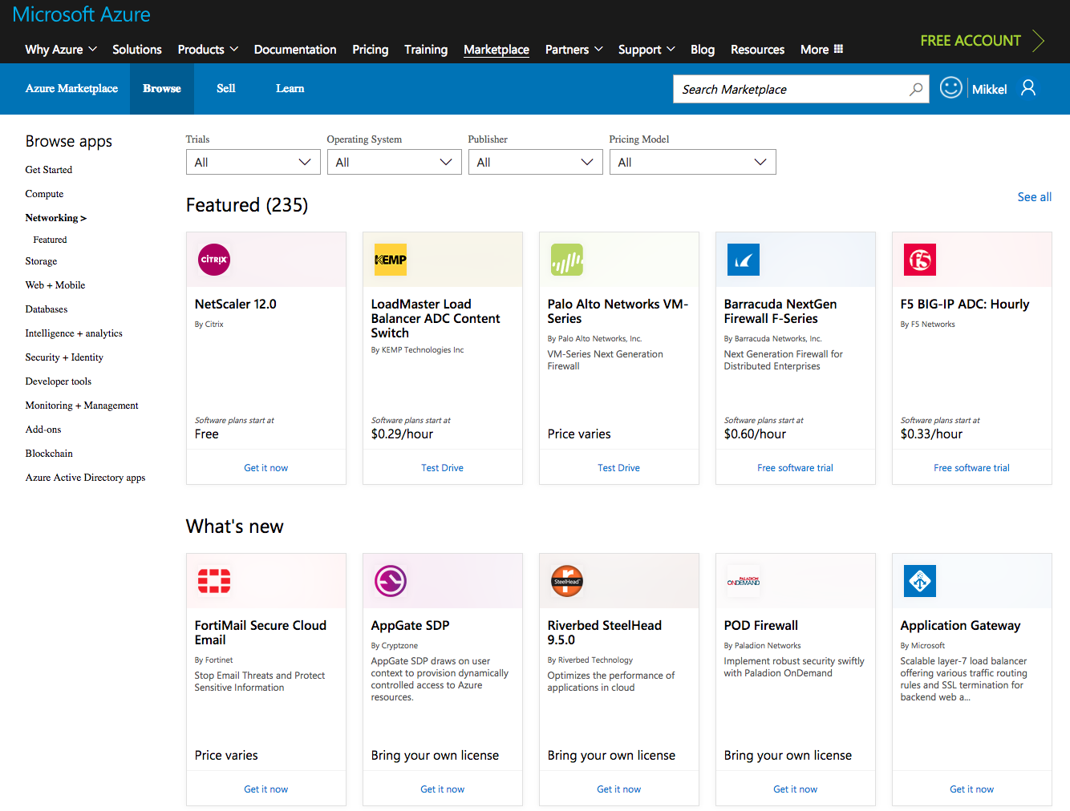
Network Virtual Appliances
Best-of-breed partner appliances through the Azure Marketplace
Extend on premises to Azure using a familiar feel
Easy to deploy, configure and manage
Notes:
Add another slide ➔ Azure Private Workload and Azure Public Services (storage, AAD, Azure Website, SQL Azure, etc.)

Slide 6
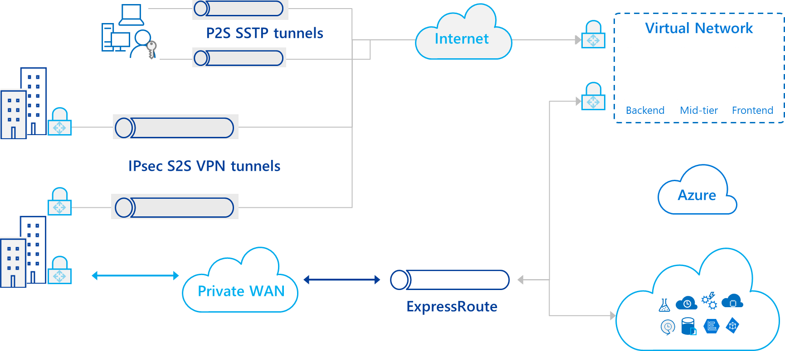
Hybrid Connectivity Overview

Slide 7





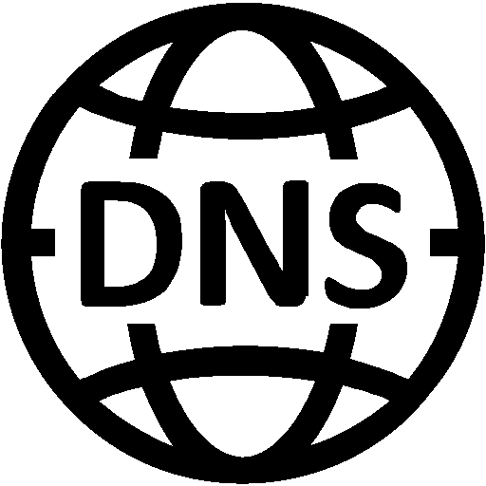

Your Network in Azure
Virtual Network
Virtual Network
Secure per customer virtual datacenter in the cloud
Instantiate and configure complex topologies in minutes
Rich security and networking services
Virtual Network
Internet
Cross premises Connectivity
Virtual Network
Virtual Network
Notes:
Add another slide ➔ Azure Private Workload and Azure Public Services (storage, AAD, Azure Website, SQL Azure, etc.)

Slide 8
Networking for all your needs
Protecting your application
Availability
Connectivity
Performance and monitoring
Notes:
With Azure, there are many ways that we’re working hard to save customers money.
This starts with our Price Match Commitment
Take price of the equation on commodity services, relative to AWS
If there is a comparable service, we’ll have the same price.
Innovative Products and Services
Low priority VMs
B-Series – a new burstable core VM size we’re disclosing soon
Archival Storage and other low-cost solutions
Cost and Governance
Cloudyn capabilities to help customers better understand and manage their spend.
Azure Advisor – helps customers optimize their resources for better performance, security, and costs
Compelling Offers
Azure Hybrid Benefit – provides the lowest cost for WS in the cloud
License Mobility – bring SQL server to the cloud
Visual Studio Subscription Azure Benefits
And to be announced soon, an updated Free Tier/Account to provide a broad range of services at no cost
In addition, to help you save more on VMs … RI

Slide 9

Protecting your application
DDOS Protection
Adaptive tuning based on platform insights and application traffic patterns
Any injected workload in the VNet is automatically protected
From the Internet
Azure DDoS Protection
Attacker
Azure Backbone
VNet
Within the
VNet
Within Azure
Advanced protection for your virtual networks
Automatic mitigation for 60+ network layer attacks

Slide 10

Protecting your application
Web Application Firewall
App Gateway
Site 1
Protect your app against prevalent X- Site Scripting and SQL Injection attacks
Blocks threats based on Top 10 OWASP signatures
Integrated with Azure Security Center
Real-time logging with Azure Monitor
Platform managed, scalable and highly available
From the Internet
Valid request
XSS attack
Within the
VNet
Valid request
WAF
Site 2
Within Azure
Valid request
SQL injection
L7 LB
Notes:
Open WEB Application Security Project

Slide 11

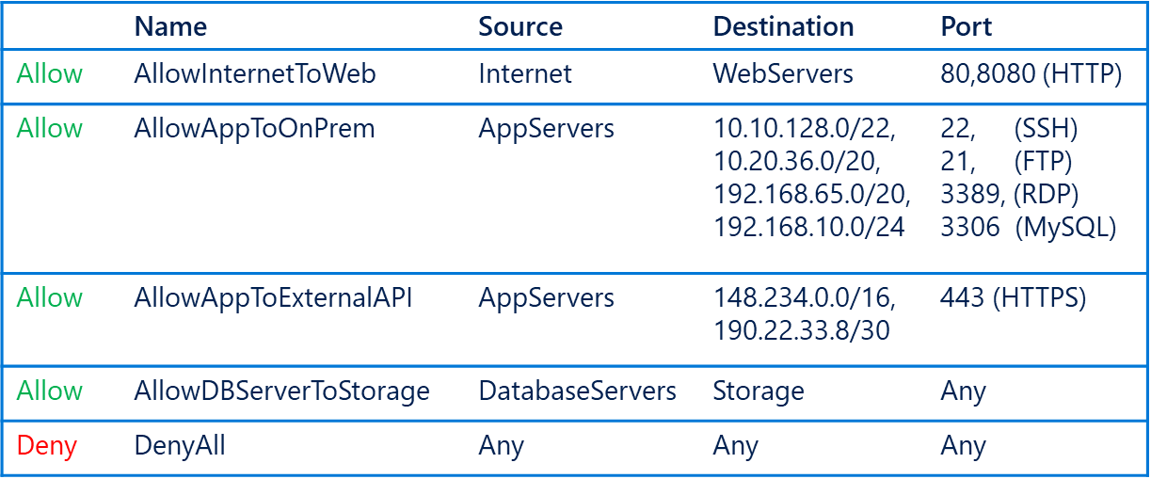
Protecting your application
Simplified Security Group Management
Network Security Groups (NSG)​
IP based network ACL​
Attach: Subnet and NICs​
Service Tags​
Named monikers for Azure service IPs​
SQL, Storage, Traffic Manager supported​​
Application Security Groups (ASG)​
Named monikers for custom grouping of VMs​
Natural expression of application security
From the Internet
WebServers
Within the
VNet
AppServers
Within Azure
DatabaseServers

Slide 12



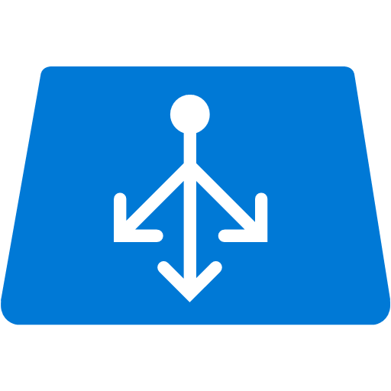




Protecting your application
Securing PaaS Services
Internet
Internet
From the Internet
VNet Service Endpoint
Within the
VNet
Within Azure
PaaS services
Compute - VNet

Slide 13
Security and Management
Azure Active Directory
Cloud based directory and identity management
Azure Resource Manager
Organize, deploy and control resources in Azure
Azure Security Center
Prevent, detect, and respond to threats with increased visibility
Azure Advisor
Optimize across four different areas: high availability, performance, security, and cost
Azure Log Analytics
Collect, search, and visualize machine data from on-premises and cloud
Azure Key Vault
Protect secrets such as passwords and keys securely
Azure Backup
Protect your virtual machines, data, or enterprise workloads by securely backing it up to Azure
Azure Site Recovery
Orchestrated failovers/back to Azure, Azure to Azure or data center to data center–great for migration!
Notes:
Azure offers all these tools to manage and secure your data including the Azure Security Center to prevent, detect and respond to threats, Azure Backup, and Azure Site Recovery

Slide 14


Azure Virtual Network Peering
10.0/16
ARM VNet10.1/16
ARM VNet10.2/16
VPN
Peering
On-Premises
Gateway transit via Peering
Direct and bidirectional L3 connectivity between VNet’s
High throughput, low latency connectivity
Bypass gateway, no bandwidth bottleneck
Supports Gateway Transit (ARM-to-ARM only)
10/50 Vnet Peering per Virtual network
Peer ASM and ARM VNet's
Peer across subscriptions
NSGs and UDRs will work across the link
Public preview – Global Vnet Peering
Notes:
Layer 3 connectivity
Connect Vnets that are in same region
Gateway Transit in ARM
ASM + ARM
Global Vnet Peering

Slide 15
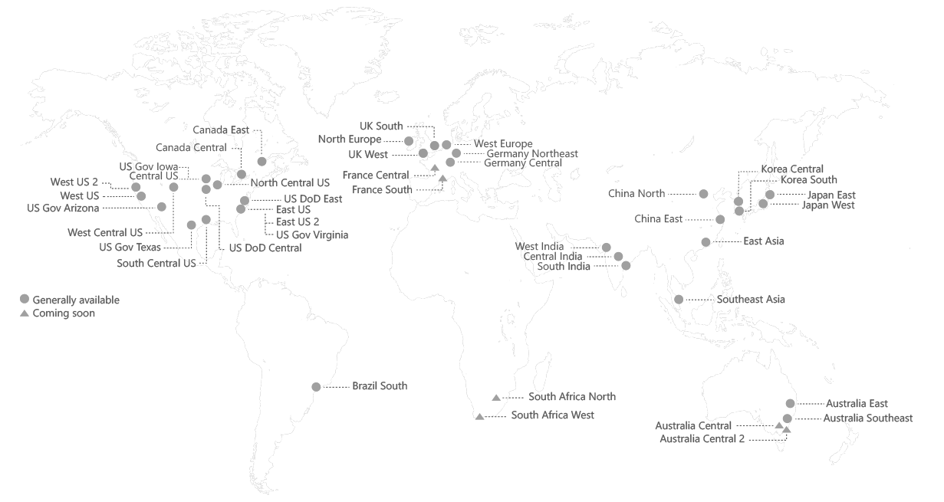


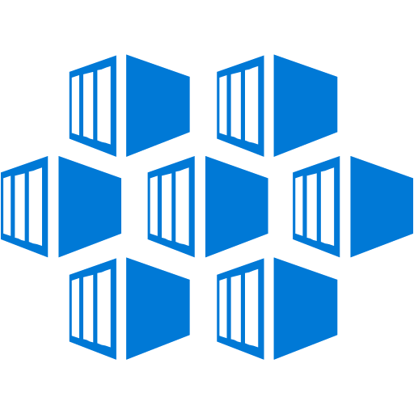




Connectivity
Global VNet Peering
Connectivity
From on-premises
VNet Peering
Azure VNet 1
Azure VNet 2
Within Azure
VNets in different regions can now be peered directly
Simple and quick to configure
Routed through the Azure backbone

Slide 16
Availability
App Gateway
Availability
fabrikam.com
Application
Layer 7 Routing
HTTP round robin
Cookie based session affinity
Multi-site hosting
URL based routing
Support Web Apps
Redirection
Security
SSL termination
SSL Policy (protocol and cipher)
End to end SSL
Application Gateway
Videos
contoso.com
Network
contoso.com/video/*
fabrikam.com
Images
Zones
contoso.com/images/*

Slide 17
Standard Load Balancer
Availability
Public IP/ILB
Application
AZ 1
AZ 2
AZ 3
Network
Zones
10x scale improvements—Increase from 100 to 1000 backend VMs
High availability through regional anycast IPs — single IP across AZs
Drastically simplified NVA Resiliency — HA Ports
Extensive health and diagnostic metrics
Notes:
VM need not be deployed in a Availability Set
Cross-Zone load balancing
Limited to region and not supported in peered networks
NIC or Subnet level NSG is mandatory
Migration from basic to standard SKU
High availability using HA ports
100/1000 Load balancers per subscription
1250/1500 rules per Basic Load Balancer
1000 Backend pools with VMs on single VNet
10 Frontend IP’s
Need to signup for preview
East US 2, Central US, North Europe, West Central US, West Europe, and Southeast Asia

Slide 18
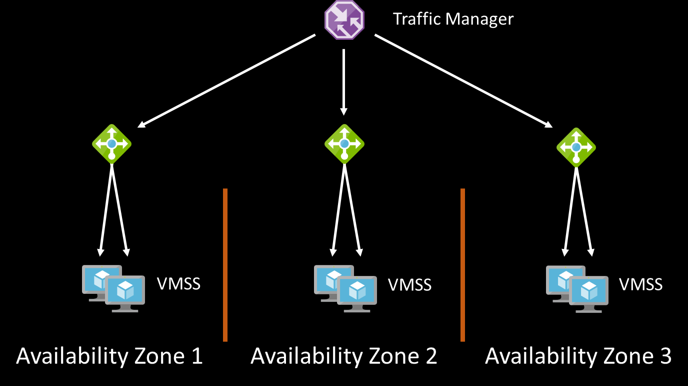
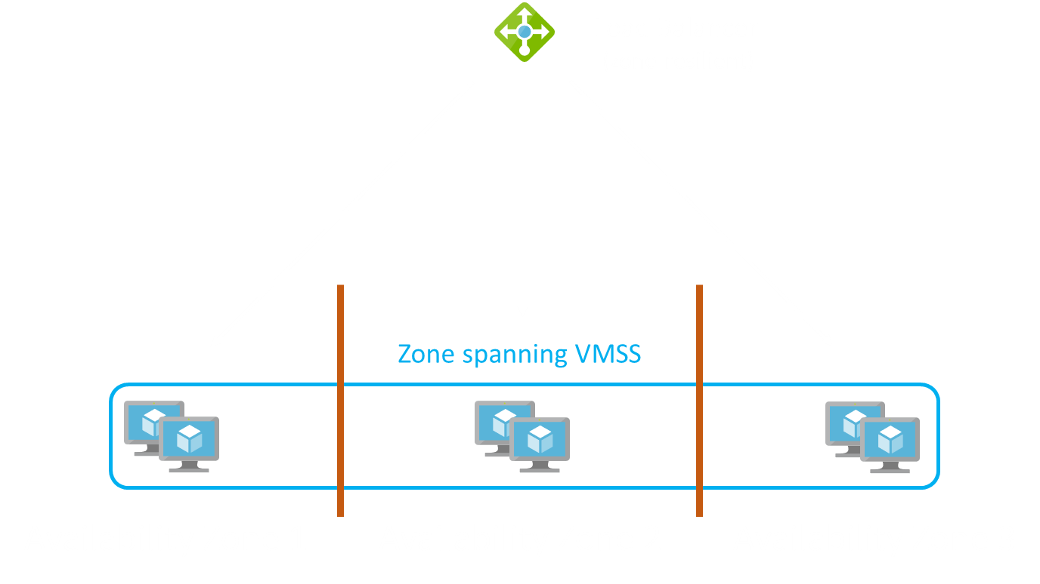
Availability Zones with Traffic Manager & Load Balancer
Availability
Traffic Manager
VMSS per Zone
TM profile for High Availability
Zonal VIP / VMSS
DNS name for cross-zone VMSS
Application
Network
Zones
Load Balancer - Standard
VMSS spans Zones
Load balancing across zones
Zone resilient VIPs
Single DNS name
VMSS limited to 1000 instances

Slide 19

VPN and Point-to-site (P2S)
Connectivity
Azure Region 1
Azure Region 2
From on-premises
VNet Peering
S2S VPN Tunnel
S2S VPN Tunnel
Within Azure
Point-to-site VPN
Site-to-site VPN

Slide 20



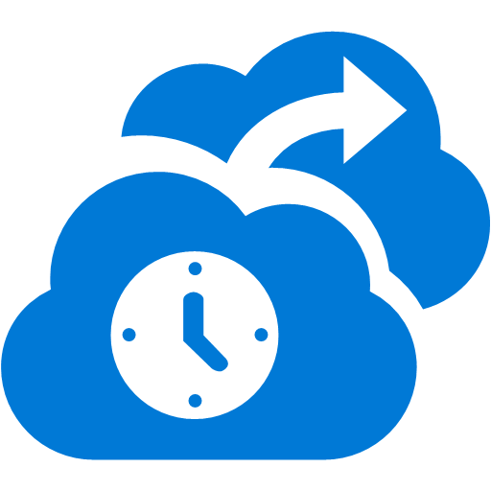


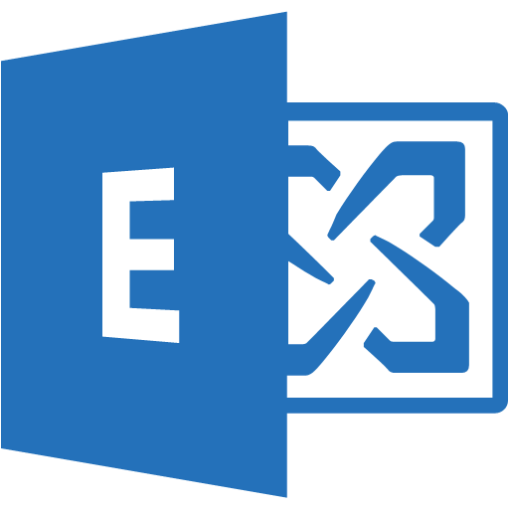
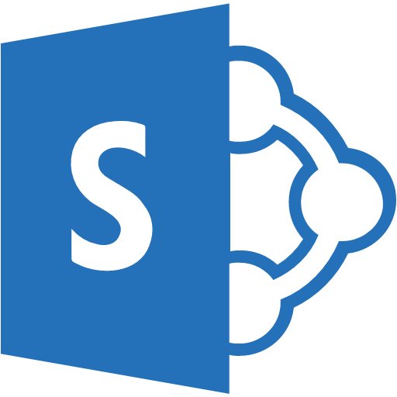




ExpressRoute
Connectivity
Microsoft Peering for Office 365, Dynamics 365, Azure Public IPs
From on-premises
ExpressRoute Circuit
Customer’s Network
Primary Connection
Partner Edge
Microsoft Edge
Primary Connection
Within Azure
Private connectivity to Microsoft bypassing the Internet
Predictable performance
Enterprise-grade resiliency with SLA
Large and growing ExpressRoute partner ecosystem
Azure Private Peering for Virtual Networks

Slide 21
Traffic Manager
www.contoso.com
Notes:
Priority -
Weighted
Performance
Geographic

Slide 22
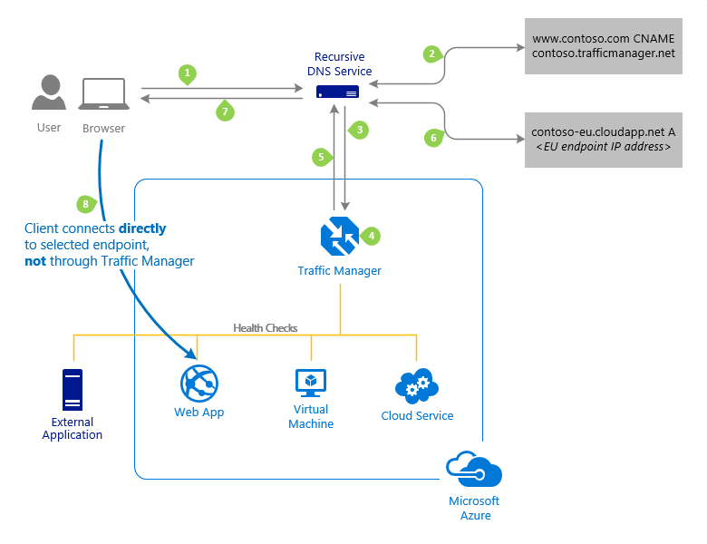
Traffic Manager
control the distribution of user traffic for service endpoints
Uses DNS to route traffic based on traffic routing method –
Priority
Weighted
Performance
Geographic
Endpoint monitoring
Benefits –
Improve availability of critical applications
Improve responsiveness for high performance applications
Perform service maintenance without downtime
100 profiles per subscription and 200 Endpoints per profile
Notes:
Service Endpoints - Azure VMs, Web Apps, and cloud services.
#You can also use Traffic Manager with external, non-Azure endpoints.
Working – uses Domain Name System (DNS) to direct client requests to the most appropriate endpoint based on a traffic-routing method and the health of the endpoints.
Priority - For backup and DR
Weighted - distribute traffic across a set of endpoints, either evenly or according to weights, which you define
Performance - "closest" endpoint in terms of the lowest network latency.
Geographic - geographic location their DNS query originates from

Slide 23
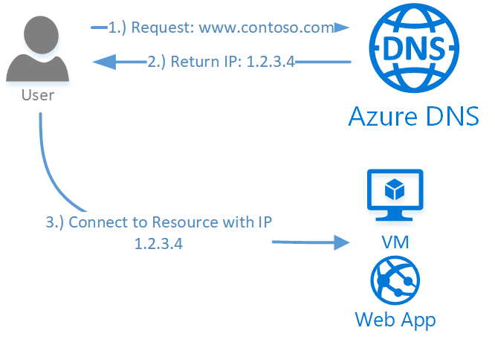
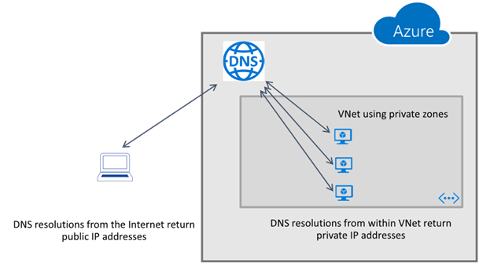
Azure DNS
Supports all common DNS record types
Azure DNS for private domains – Preview
No Configuration and is Highly Available
DNS service to manage and resolve domain names in a virtual network
WINS and NetBIOS not supported
Removes the need of custom DNS solutions
Split-horizon DNS support
Import or Export DNS zone files to and from Azure
99.99% SLA
100 DNS zones per subscription
5000 record sets per zone
20 records per record set
Notes:
DNS Record types
Private domains
Private to the Vnet
No WINS or NetBIOS
No Custom DNS
Split Horizon – Private and Internet
DNS Zone Files
99.99% SLA on Azure DNS
Forwarded DNS Requests are sent to reserved IP 168.63.129.16
20/100 DNS servers per Vnet

Slide 24
Performance and Monitoring
Accelerated Networking
30 Gbps VM to VM bandwidth!
Region
Azure VM
Azure VM
Performance
Monitoring
Accelerated Networking
Accelerated Networking
30Gbps
30Gbps

Slide 25

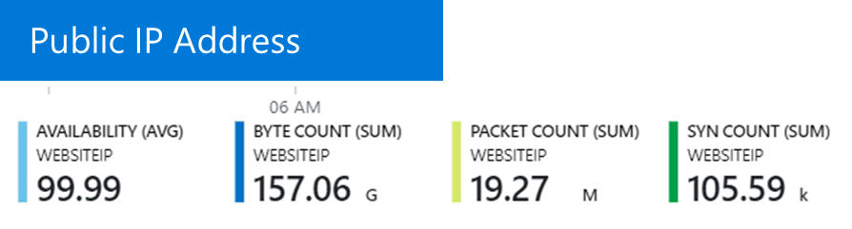
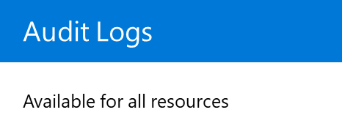
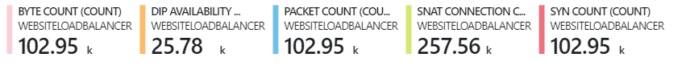
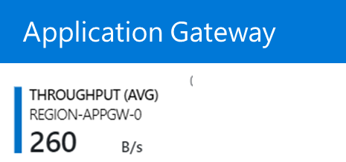
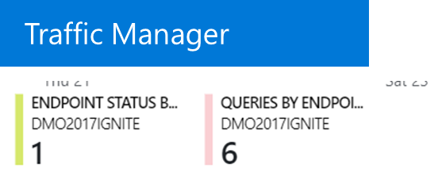
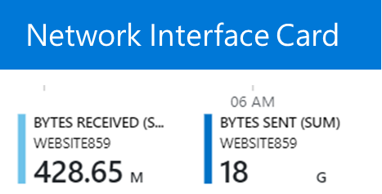
Performance and Monitoring
Monitoring your resources with Azure Monitor
Performance
Load Balancer
Monitoring
Virtual network gateway

Slide 26
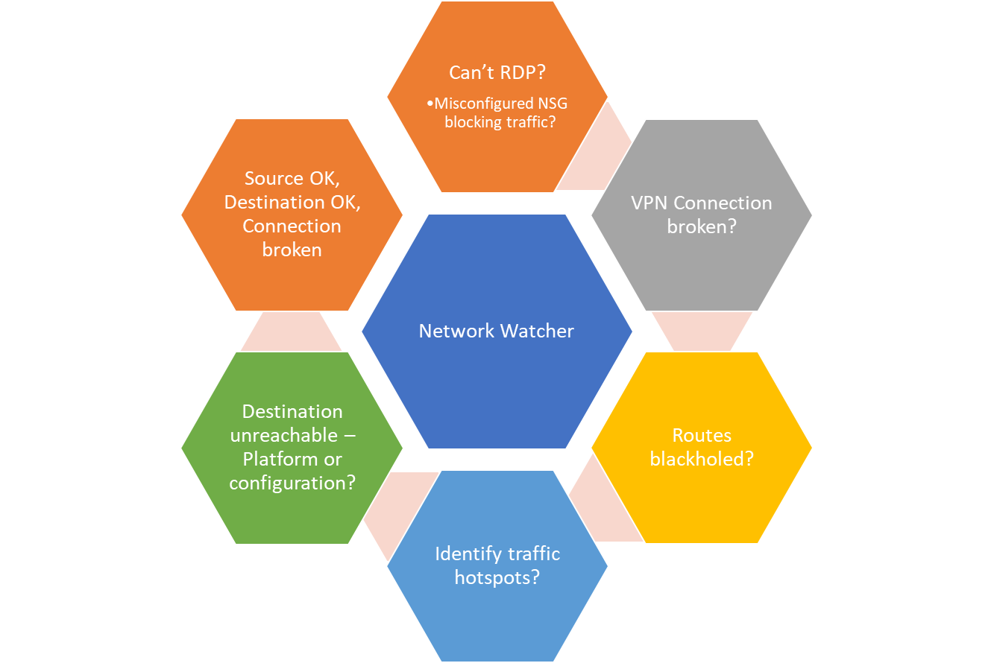
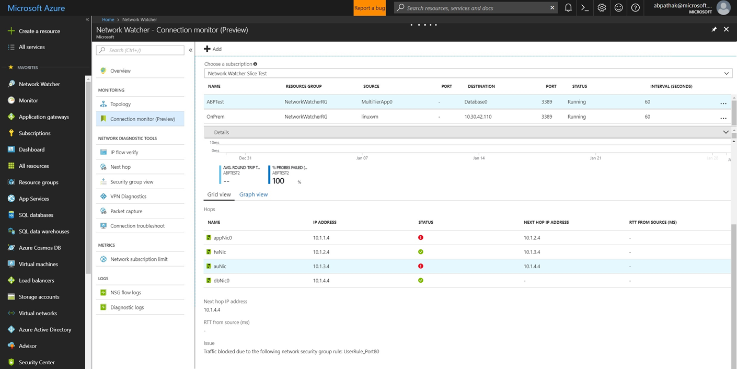
Performance and Monitoring
Diagnose & Visualize Scenarios with Network Watcher
Performance
Monitoring

Slide 27
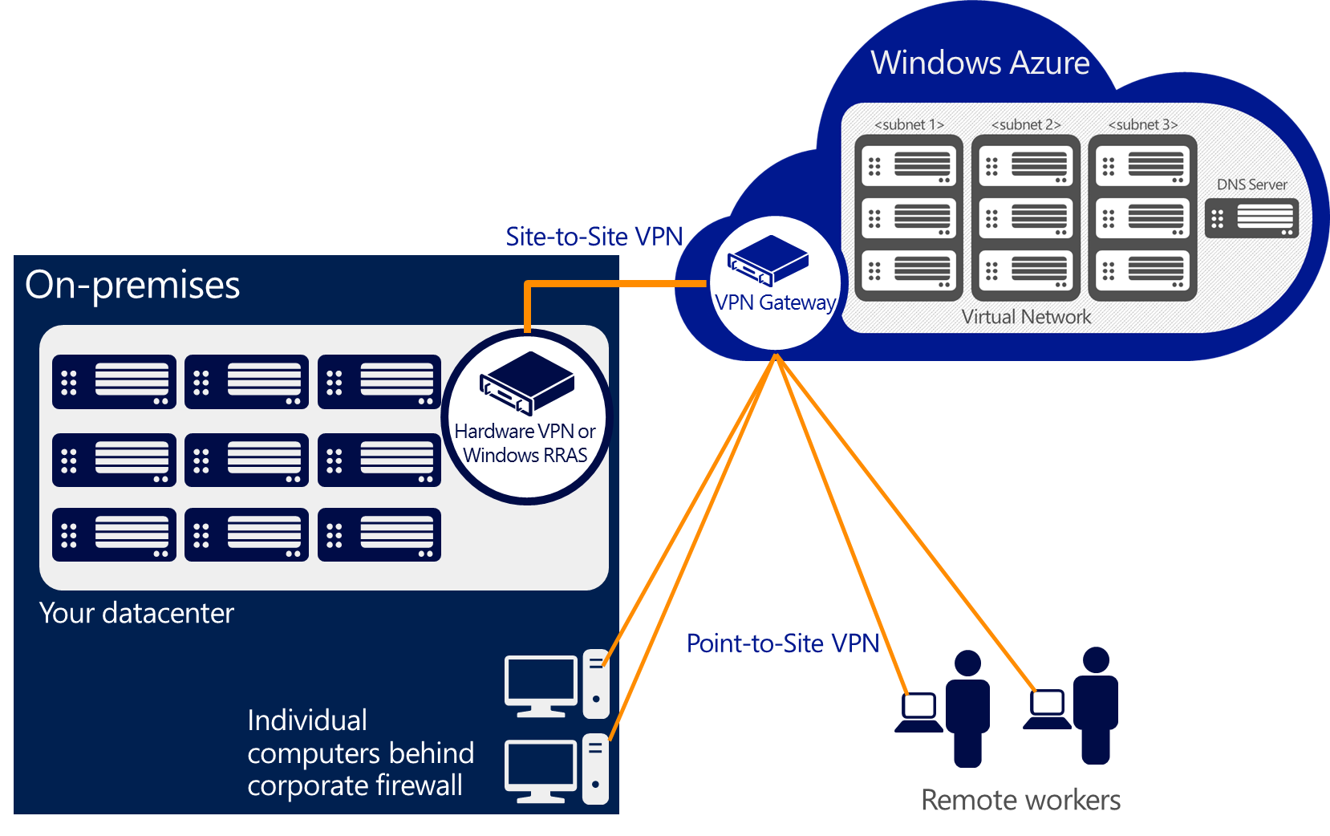
Virtual Private Network
Route Based SKU | S2S/VNet-to-VNet Tunnels | P2S Connections | Aggregate Throughput Benchmark
VpnGw1 | Max. 30 | Max. 128 | 650 Mbps
VpnGw2 | Max. 30 | Max. 128 | 1 Gbps
VpnGw3 | Max. 30 | Max. 128 | 1.25 Gbps
Basic | Max. 10 | Max. 128 | 100 Mbps
At a high level, most hybrid configurations require 5 resources:
VNET
Gateway Subnet
Virtual Network Gateway (Route/Policy Based)
Local Network Gateway
Connection
Notes:
Route Based – Dynamic Routing VPN – IPSec Tunnel
Basic – 10
GW1,2,3 – 30 Tunnels
Policy Based – Static Routing VPN – Customer defined policy (access list) – VPN Client
1 S2S VPN
IKEv1 and IKEv2
Resources for VPN
Pre Shared Key

Slide 28
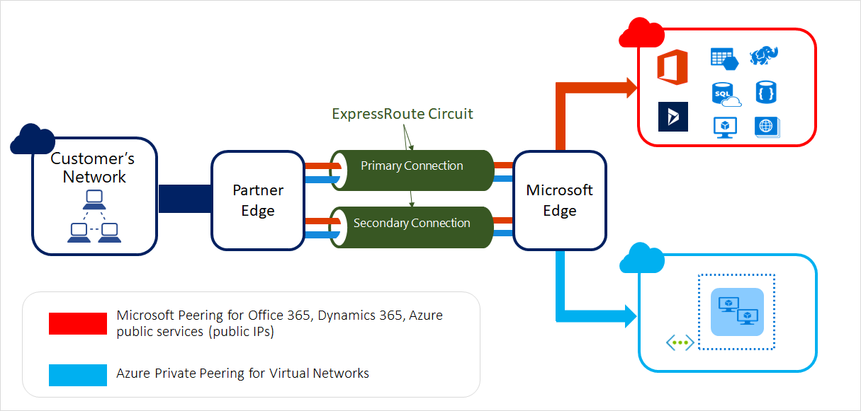
Express Route
Layer 3 connectivity between your on-premises and Azure
Dynamic routing between your network and Microsoft by leveraging BGP
Built-in redundancy
Range of bandwidth options
Flexible billing models
Unlimited data
Metered data
Premium add-on
Prerequisites
Azure Account
Connectivity Providers
Network Requirements
Notes:
Microsoft MPLS network
Public and Private peering
Built in Redundancy
Dynamic Routing
--
Private line through a connectivity provider
Not on public internet
More Reliable , Faster speed, low latency, high security
Billing
Billed monthly
Free inbound , Billed Outbound with per GB of data Transfer
Prerequisites NW requirements–
NAT – Public Peering only accepts traffic from public IP
Redundancy – Redundant BGP sessions setup between MS routers and peering routers

Slide 29
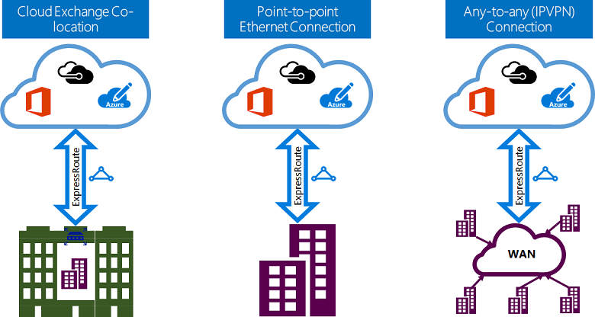
Express Route Connectivity Models
Notes:
Co-lo
Infrastructure deployed at Colo
Provider set up layer 2 of layer 3 connection from Colo to Azure
Point-to-Point
Connect your HQ to Azure and route all the Branch office traffic to HQ and from HQ to Azure
IP VPN – MPLS VPN
The Microsoft cloud can be interconnected to your WAN to make it look just like any other branch office.

Slide 30
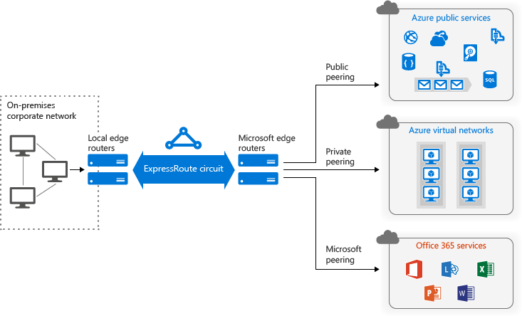
Express Route: Routing Domains (Peerings)
Notes:
Public – Azure Public Services
Microsoft – Office 365
Private – Vnet

Slide 31
Express Route Standard vs Premium Add-on
Number of Routes | Express Route | Premium add-on
Private Peering | 4,000 | 10,000
Public Peering | 200 | 200
Microsoft Peering | 200 | 200
Circuit Size | Number of VNet links for standard | Number of VNet Links with Premium add-on
50 Mbps | 10 | 20
100 Mbps | 10 | 25
200 Mbps | 10 | 25
500 Mbps | 10 | 40
1 Gbps | 10 | 50
2 Gbps | 10 | 60
5 Gbps | 10 | 75
10 Gbps | 10 | 100
Global connectivity for services - An ExpressRoute circuit created in any region
(excluding Azure China, Azure Germany, and Azure Government cloud)
will have access to resources across any other region in the world.
Notes:
Increased no of Vnet links
Increased route limits
Global connectivity with premium add-on–
Link Vnet in West Europe to Express Route provisioned in West US

Slide 32
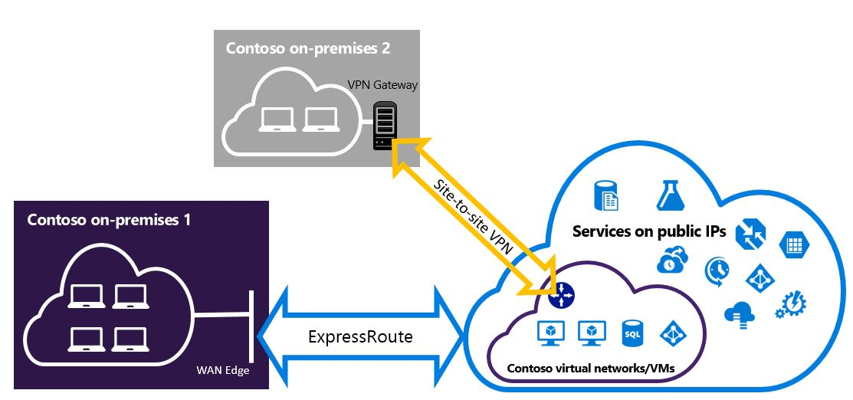
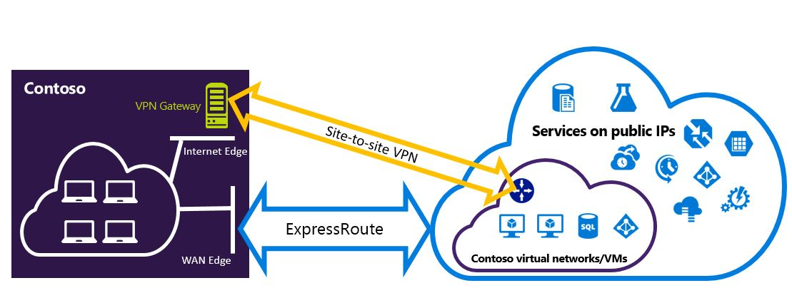
Express Route and Site-to-Site Co-Exist
Notes:
S2S is backup for Express Route
Add a new branch using S2S tunnel
Same gateway that we use for Express Route

Slide 33
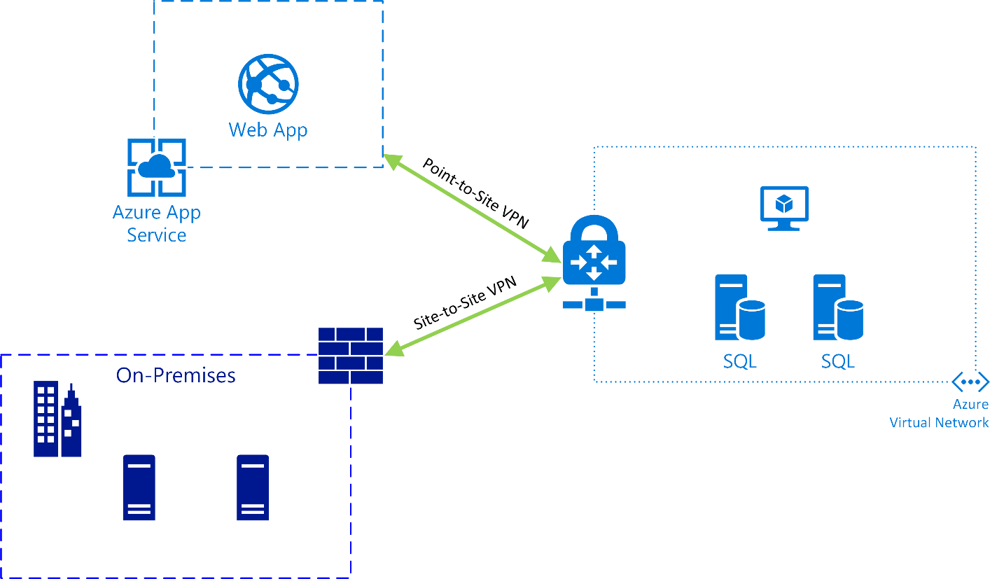
Integrating Web App with Virtual Network

Slide 34
 | Point-to-Site | Site-to-Site | ExpressRoute
Azure Supported Services | Cloud Services and Virtual Machines | Cloud Services and Virtual Machines | Services list
Typical Bandwidths | Typically < 100 Mbps aggregate | Typically < 1 Gbps aggregate | 50 Mbps, 100 Mbps, 200 Mbps, 500 Mbps, 1 Gbps, 2 Gbps, 5 Gbps, 10 Gbps
Protocols Supported | Secure Sockets Tunneling Protocol (SSTP) | IPsec | Direct connection over VLANs, NSP's VPN technologies (MPLS, VPLS,...)
Routing | Route Based (dynamic) | We support Policy Based (static routing) and Route Based (dynamic routing VPN) | BGP
Connection resiliency | active-passive | active-passive or active-active | active-active
Typical use case | Prototyping, dev / test / lab scenarios for cloud services and virtual machines | Dev / test / lab scenarios and small scale production workloads for cloud services and virtual machines | Access to all Azure services (validated list), Enterprise-class and mission critical workloads, Backup, Big Data, Azure as a DR site

Slide 35

Design Security Strategies
Notes:
Add network Watcher
Flow verify traffic
TS NSG logs
Packet captures
Enable NW
Add extension to the VM

Slide 36
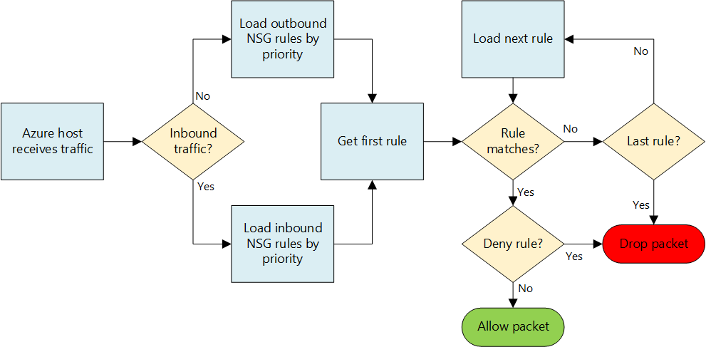
Network Security Groups
Control inbound and outbound traffic on a NIC or subnet level
Configure rules in NSG
Name
Source address
Source port
Protocol (TCP/UDP/ICMP)
Destination address
Destination port
Direction
Action (Allow/Deny)
Augmented Rules
100/200 NSG’s per subscription
200/400 Rules per NSG
Notes:
NIC or Subnet Level
Inputs to configure rules
Augmented rules = Large & Complex network policies with less rules on a NSG
multiple ports and IPs on a single rules

Slide 37
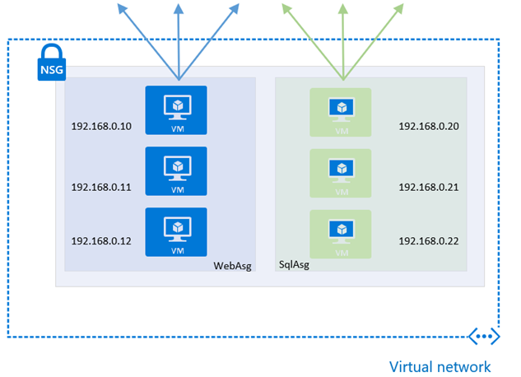
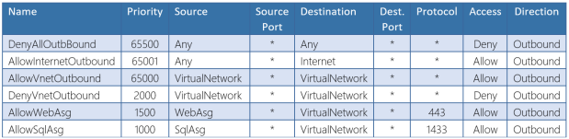
Application Security Groups
Preview
network security as a natural extension of an application’s structure
network interfaces of VMs are assigned to an application security group
application security group are provided as the source and destination in a security rule
The platform handles the complexity of explicit IP addresses and multiple rule sets
Notes:
Security as extension on application level
NIC of VM to ASG
ASG as source or destination on NSG
Reduce –
Complexity of explicit IP addresses
Multiple rule sets

Slide 38
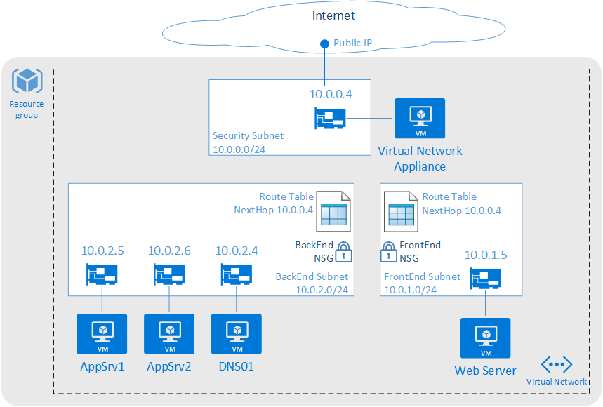
Route Tables
User defined routes
Routes to overwrite Azure system routes
Associated to subnets
Specify next hop
Virtual Appliance
Virtual Network Gateway
None
Virtual Network
Internet
Configure routes in route table
Route Name
Address Prefix (Destination Address)
Next hop type
Next hop address (Virtual Appliance)
100/200 Route Tables per subscription
100/400 routes per Route Table
Notes:
User Defined Routes
Ability to control traffic flow
Imagine we have two subnets within one Vnet
By default all machines in a Vnet can communicate with each other so there is full routed network between them
You don’t want your front end subnet communicate directly with your back end subnet
You want to have your own firewall appliance or an IDS system in between the traffic flow to accomplish that solution we can use User Defined Routes to force the traffic coming to backend subnet that is coming from front end subnet through the firewall instance
You can configure UDR’s for both internal traffic and the traffic leaving your Azure network

Slide 39

Design Connectivity for Hybrid Applications

Slide 40
Thank You

Slide 41
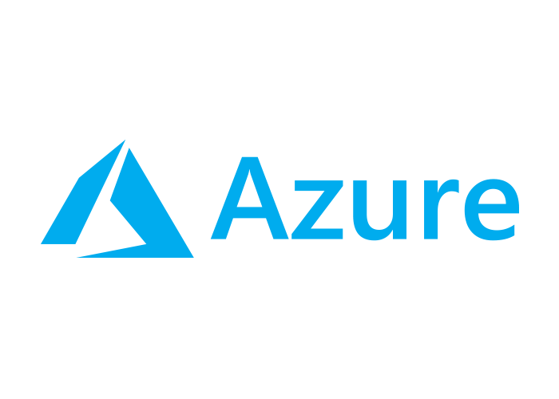
Design Connectivity for Hybrid Applications

